Slide 1
Creating a Vista Spyder Tally Controller
Using a Raspberry Pi 2 and Windows 10 IoT Core
Notes:
In this video, we’re going to take a look at putting together a tally controller for the Spyder video processor. At the end of this video, we’ll have a device that will toggle relays on and off based on specific sources going on and coming off screen. We’ll get started by setting up some hardware, and then we’ll write an application which will listen to Spyder traffic and manage our tallies.

Slide 2
Hardware Overview
Notes:
Let’s get started by taking a look at the hardware platform we’ll be working with. Over the last year, there’s been an explosion of small, cheap, general purpose hardware devices, and as a result we have a number of off the shelf solutions available to tackle this project. I’ve decided to use the Raspberry Pi 2 hardware platform, and so let’s take a second to look at this amazing little board.

Slide 3
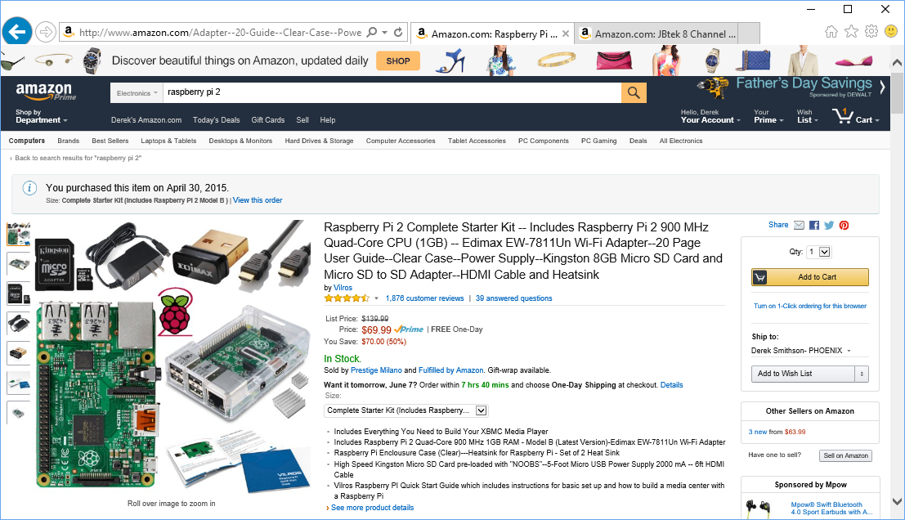
Powered by Raspberry Pi 2
$35 stand-alone board
$70 as a kit on Amazon
Quad-Core 900 Mhz processor
1GB RAM
100Mb Ethernet
Tons of IO
Runs Linux or Windows 10
Notes:
For $35, the Raspberry Pi 2 is an incredible offering which packs a quad-core 900Mhz processor, a Gigabyte of RAM, a 100Mb Ethernet connection, a ton of IO interfaces, and supports running a few different variants of Linux, and even an embedded variant of Windows 10 that Microsoft launched at the the end of April 2015. I’d recommend grabbing this up as a Kit from Amazon, which will run around $70, but includes a Wifi adapter, SD card to hold the OS, a power adapter, and a few other goodies.

Slide 4
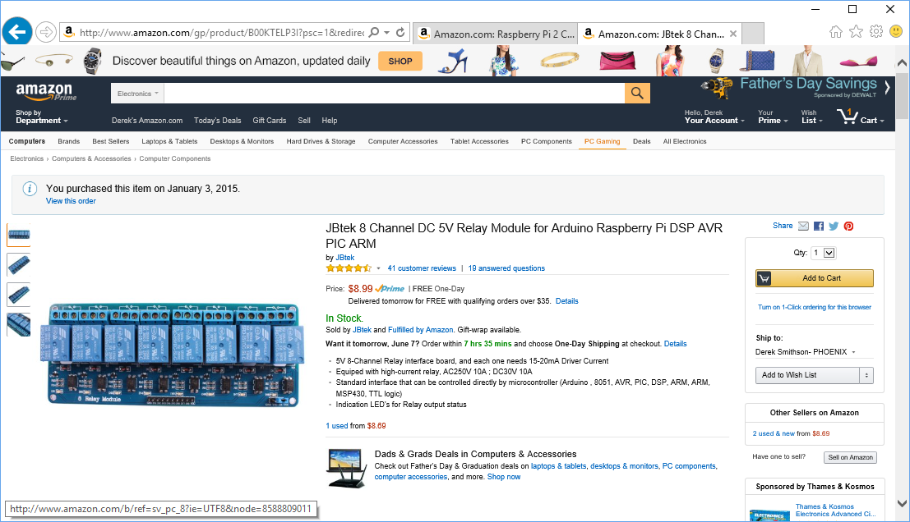
Tally/Relay Board
Jbtec 8 Channel 5V Relay Module
$9 on Amazon
Each relay supports:
AC 250V @ 10 Amps
DC 30V @ 10 Amps
Has built-in status LEDs
Connects to our Pi via 8 GPIO Pins
Notes:
To switch our camera tally relays, we’re going to connect our Pi to this 8-channel relay board. I picked this guy up on Amazon for $9. This is a simple board that has 8 input pins to control whether it’s individual relay contacts are open or closed, and is perfect for our tally controller project.

Slide 5
Hardware Wiring Diagram
Notes:
The Pi has a 40 pin header that exposes it’s various IO options, and I’ve chosen 8 general purpose Input/output pins to drive our relays. We’ll also need to pull over a +5V line and ground wire from the Pi to our relay board’s header. Once these two boards are connected together, we’ll effectively have a working device – minus the software.

Slide 6
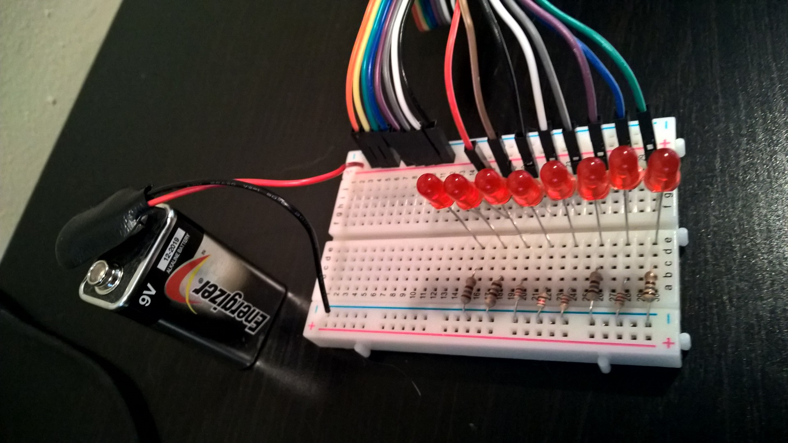
Hardware Wiring – Test Harness
Simple circuit to light up an LED for each of the 8 relays.
When closed, the relay will complete the circuit being powered by a standard +9V battery, and light our LED.
Notes:
One last bit… As a test harness for our project I’ve populated a small breadboard with 8 LEDs which will serve as our tally light simulator. This will help us with debugging and allow us to see our tally controller actually working.

Slide 7
Let’s take a look
- Time to see some hardware
Notes:
Here’s what our project hardware looks assembled. It may not look too fancy sitting loose on my desk, but you can imagine that it would be straight-forward to make it into a legitimate piece of gear by mounting the pi and the relay board into a real chassis. For now, since we’re all connected up, let’s switch over to the code and build our tally controller application.

Slide 8
Software Overview
Notes:
Now it’s time to turn our focus to the software portion of our project. As a primer, we’ll spend a minute talking about a couple aspects of how your Spyder is working under the covers, and how we’ll be able to leverage its architecture in our project. Then we’ll spend a minute discussing the OS and application platform, and then we’ll finally dive into some code.

Slide 9
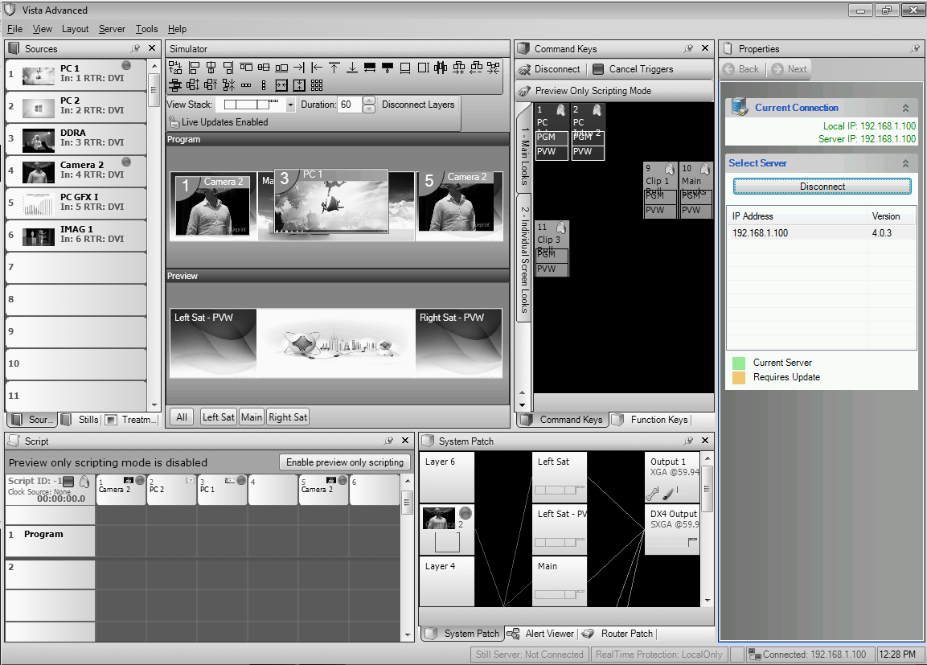
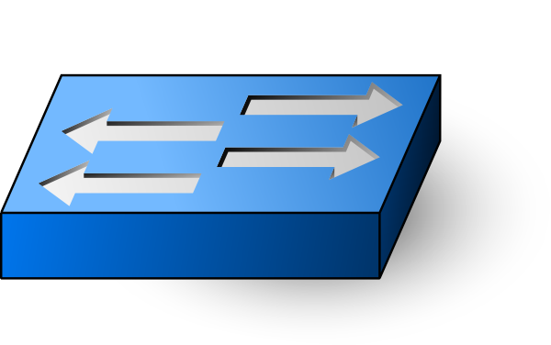
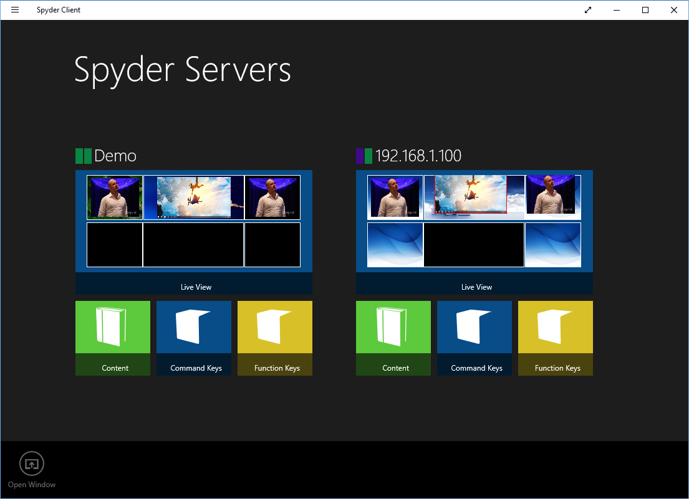
Networking: Server Discovery
Broadcast Data
Broadcast Data
Broadcast Data
Broadcast Data
Network Switch
1. Spyder servers send a UDP broadcast every 10-30 seconds to announce their presence to the network
2. Client applications on the network detect servers by listening for UDP broadcasts from Spyder servers
Notes:
You likely already know that Spyders talk on an Ethernet network. What you may not know is that they use a combination of TCP and UDP connections to communicate with clients. Spyder servers send a UDP broadcast onto the network somewhere around every 10-30 seconds to announce their presence. Client applications like Vista Advanced and the Spyder Client application in the Windows Store listen to the network for these broadcast messages, and use them to populate their server lists. Before a user even connects, the client applications can establish background connections to the server or start listening to other network messages to provide a more rich user experience. The Spyder Client, for example, shows the live simulator view of each Spyder on the network as part of it’s server selection screen.

Slide 10
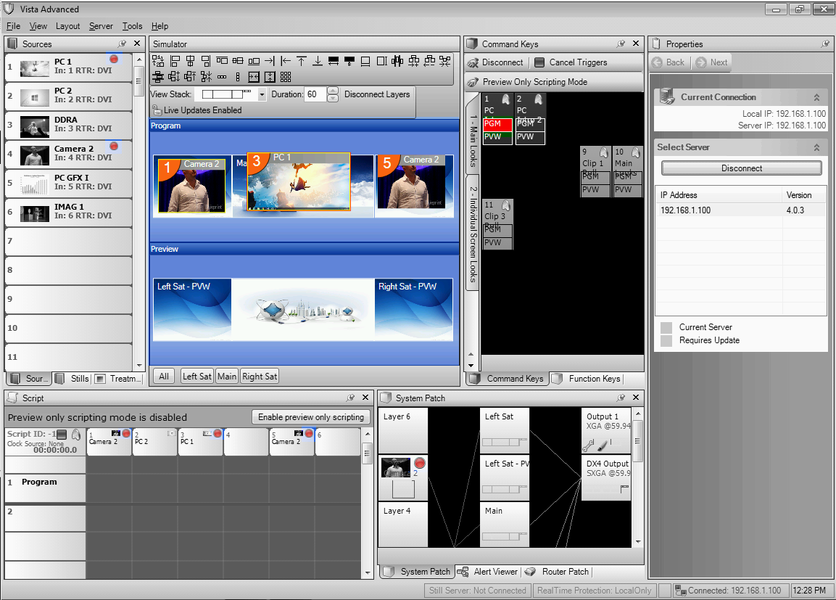
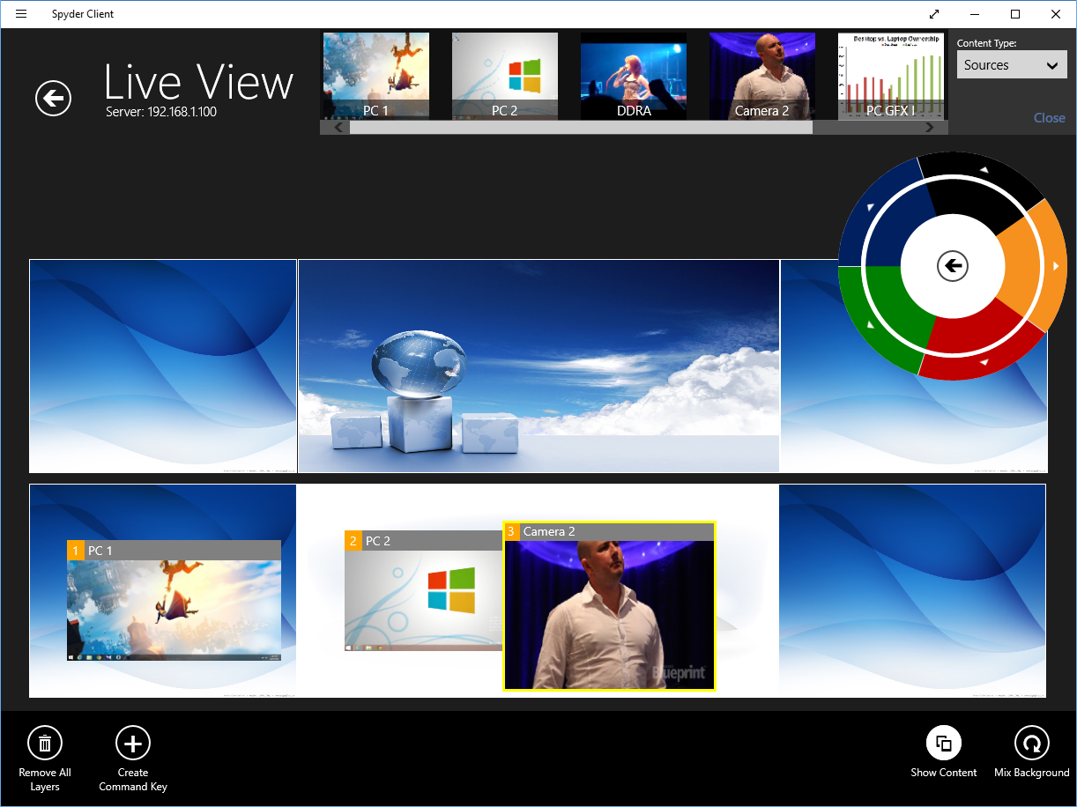
Networking: Live Data (Drawing Data)
Multicast Data
Multicast Data
Multicast Data
Multicast Data
Network Switch
1. Spyder servers send compressed UDP multicast messages to the network once per second, or faster while layers are in motion.
2. Client applications on the network join the multicast group and receive drawing data messages from servers
Notes:
The real-time state of the Spyder server, including layer keyframes, outputs, router assignments, DDR playback, and pixelspaces, are transmitted as a UDP multicast stream onto the network. The amount of data transmitted can be fairly large, and is tightly packed into a proprietary format, which is then compressed before transmission. The rate of update transmissions is generally one per second when all layers are idle, and ramps up when layers are in motion. Client applications on the network can subscribe to the multicast group to receive this information, and as long as they know how to decompress and deserialize it, they effectively have access to real-time server status without ever having to poll the server.

Slide 11
Networking: Live Data (Drawing Data)
Multicast Data
Multicast Data
Multicast Data
Multicast Data
Network Switch
The use of multicast data allows the Spyder servers to send the data once to the network, and be picked up my any number of Spyder client applications on the network without adding additional overhead to the Spyder servers
Notes:
That last point is important - the use of multicast traffic to serve multiple clients simultaneously means that the Spyder server can serve a large number of clients without incurring additional overhead from each client. Effectively the Spyder server doesn’t care if it has 0, 1, or 100 clients connected at any given time.

Slide 12
Adding the Tally Controller to the network
Multicast Data
Multicast Data
Multicast Data
Multicast Data
Network Switch
Our Tally controller will listen to the same server discovery and live data network messages that the desktop client applications use, to allow near real-time performance without adding overhead to the Spyder servers
Notes:
To be a good Spyder citizen, our tally controller is going to listen to these same broadcast and multicast messages, effectively leaving the Spyder servers unaware that our tally controller is on the network at all.

Slide 13
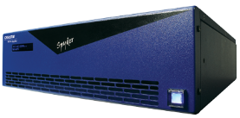
How we’re not doing it…
(Using External Control Commands)
Request Layer 1 Status from Spyder
Send Layer 1 Status Response to client
Request Layer 2 Status from Spyder
Send Layer 2 Status Response to client
Request Layer 3 Status from Spyder
Send Layer 3 Status Response to client
.
.
.
Another option would be to use the external control protocol to query each layer on the server in a tight loop to determine which sources are visible in a program PixelSpace. While this will technically work, it will be generally slower, much chattier on the network, and may have a noticeable overhead on the Spyder server.
Notes:
Not to berate the point, but let’s talk for just a second about how we’re not implementing our tally controller. One alternate way of building our software would be to leverage Spyder’s external control protocol to poll for the layer status information we need to determine which sources are visible in program PixelSpaces. This code would have us in a tight loop, querying for layer keyframe and source information one layer at a time, and would use up a decent amount of network bandwidth and Spyder processing power. On a larger system with something like 32 or more layers, it could take a while to get through a full loop, causing the tally switching to appear sluggish or delayed. Note that for most implementations, the polling route is likely the only way to go. De-serializing the drawing data messages on the network is hard - especially since they aren’t publicly documented - and without leveraging an existing library to handle this for us the project would be exponentially more complicated. Luckily, we will be leveraging an open-source Spyder Client library written for .Net desktop and store applications on the Windows platform.

Slide 14
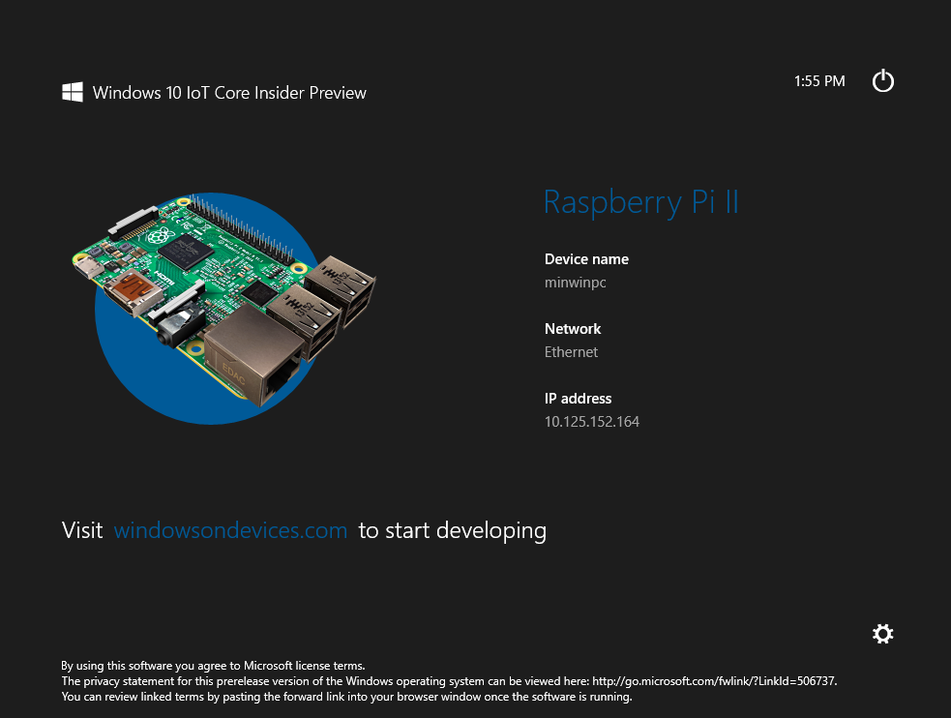
Windows 10 on Raspberry Pi 2
At the end of April 2015, Microsoft released a preview version of it’s free Windows 10 IoT (Internet of Things) core edition targeting the Raspberry Pi 2.
This edition of Windows 10 is heavily stripped down version of the OS, designed for the embedded device.
This OS omits the traditional desktop UI and the majority of background services found on full desktop installations
Runs Windows 10 universal applications
Get Started at: http://ms-iot.github.io/content/en-US/win10/SetupRPI.htm
Notes:
To leverage the Spyder Client library, we’ll be running Windows 10 IoT Core as the OS on our Raspberry Pi 2 board. This edition of Windows was released as a preview at the end of April 2015, and it’s essentially a compact, stripped down version of the Windows OS. Missing from this OS is any desktop user interface and most of the background service gak needed for the desktop OS. It’s designed to run an embedded-style application, and by using it we can leverage existing libraries written for the Windows platform.

Slide 15
Software Components
Windows 10 IoT Core
Operating System for Raspberry Pi 2
Windows Universal Application
Our custom application targeting Windows 10
Windows IoT Extension SDK
Adds support for controlling GPIO hardware on our Raspberry Pi 2
Spyder Client Library
Adds support for interacting with Spyder servers over a network
Notes:
So here’s the full software stack - we’ll be running Windows 10 IoT Core as our operating system, and we’ll be writing our tally controller as a universal Windows application. Our application will leverage the Windows IoT Extension SDK to give us access to the GPIO ports on our Raspberry Pi, and we’ll pull in the Spyder Client library from Nuget to handle our Spyder communication.

Slide 16
Software Application Flow
Application Start
Initialize our 8 GPIO pins, and set them to low (off state)
Initialize a SpyderClientManager, and subscribe to an event notifying us of Spyder servers detected on the network.
When our target Spyder server is detected, subscribe to an event which gives us the real-time data feed for that server.
In the handler for our real-time data feed (Drawing Data), loop through the layers to find which of our sources are visible in program, and turn the corresponding GPIO pins on and off.
Run indefinitely – tallies will be re-evaluated and updated every time we receive a drawing data message from the network.
Notes:
The application we write will look something like this –
Note that in this first video, we’re going to hard-code the Spyder Server IP address and the sources that we want to trigger our tallies on. In a subsequent video, we’ll write a desktop application to configure the server and tally sources on our Pi.

Slide 17
Let’s go write some code
Notes:
Now that we’ve talked through everything, let’s actually put it together and see something work.

Slide 18
Summary
What did we do, and what will we do next?
Notes:
So let’s finish up with a quick summary. Throughout this video, we connected a relay board to a raspberry pi 2 running Windows 10 IoT Core, wrote a Windows Universal application to switch the relays based on Spyder sources displayed on screen, and finally we deployed that app and were able to see it running.
So we now have our controller technically working, but we’ve left it hard-coded with the Spyder server address and the source names being used to control the tally relays. In the next video, we’ll clean that up by adding a desktop application that can configure the tally controller remotely. Until then, I hope you enjoyed the video and I thank you for watching.

